Slide 1
Seminar Title Security Issues in Cloud Computing
Technical Seminar
By
Nikitha M V
231047013
ME –Cloud Computing
Under the guidance of
Panel Member 1: | Panel Member 2:
Prof. Dr Darryl Jeethesh Dsouza | Prof. Mr Sreepathy H V
Associate Professor | Assistant Professor
Manipal School of Information Sciences | Manipal School of Information Sciences
MAHE, Manipal | MAHE, Manipal

Slide 2
Presentation Outline
Introduction
2. Objectives
3. Literature Review
4.Description
5.Precaution measures
6.Conclusion
7.References

Slide 3
1. Introduction
What is Cloud Computing ?
Cloud computing is a term used to describe the delivery of on-demand computing resources—hardware, storage, databases, networking, and software—to businesses and individuals via a network.
Advantages of Cloud Computing are Scalability, mobility, Easy Collaboration,Reduction in cost,Resource Efficiency.
Disadvantages of Cloud Computing are less control over underlying cloud infrastructure, Vendor Lock-in,Limited access offline and Security Risks.

Slide 4
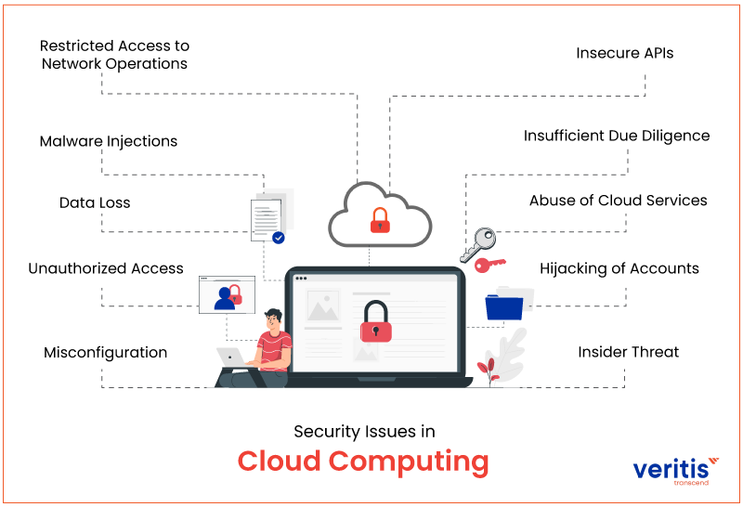

Slide 5
3. Literature Review
Paper title: Security Issues and challenges in Cloud Computing
Published in the year November 2022
Authored by Hussain Akbar, Muhammad Zubair and Muhammad Shairoze Malik
Key Findings: Different security challenges while migrating to cloud , Data leakage being the most common and dangerous risk.
Mitigation strategies to combat these limitations or challenges .

Slide 6
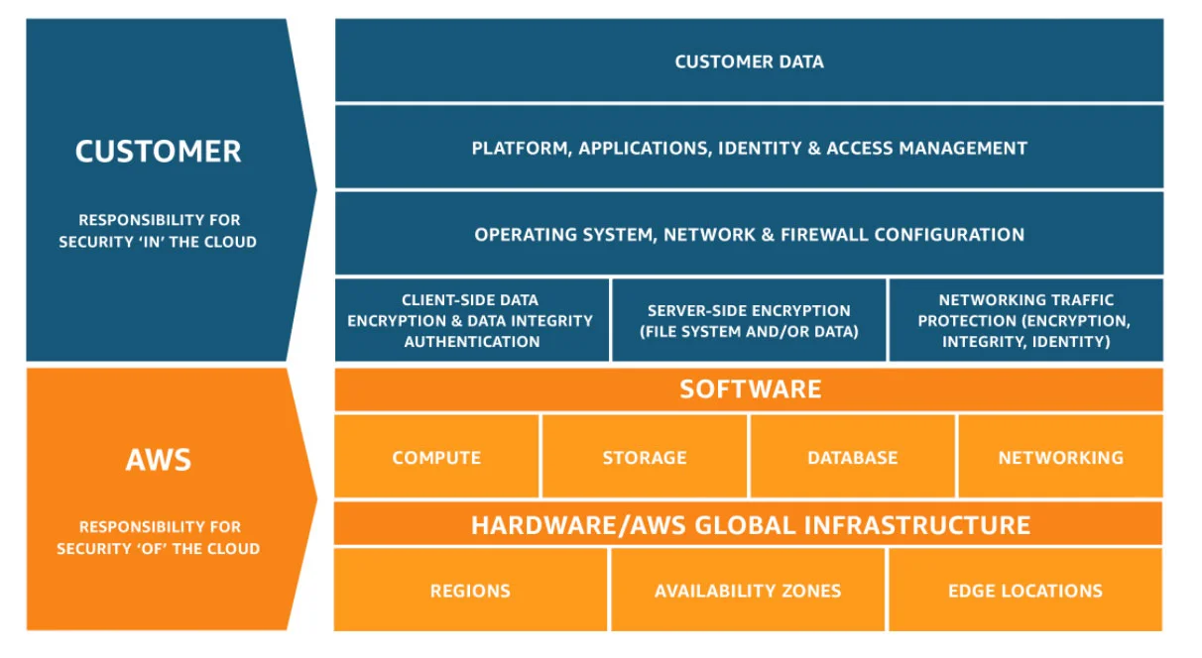
Security Architecture of cloud computing

Slide 7
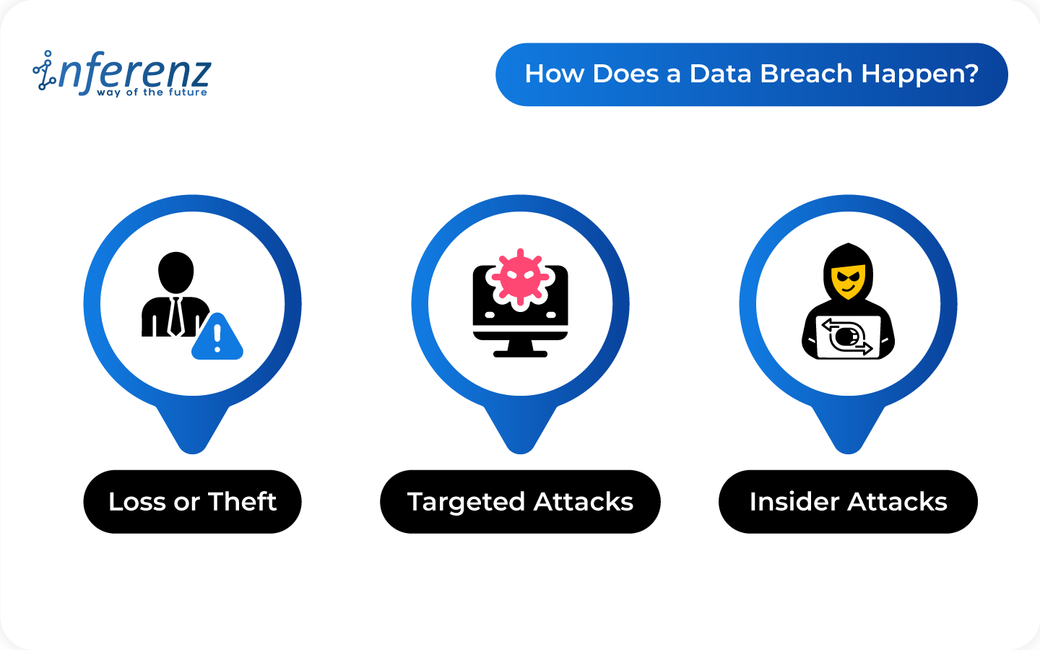
Data Loss/Leakage
Data leakage in cloud computing refers to the unauthorized or unintentional exposure, transmission, or access of sensitive data stored in the cloud.
Causes of Data Leakage :
Inadequate Access Controls
Phishing and Social Engineering
Misconfigured Storage Buckets
Third-Party Services
Notes:
Weak or misconfigured access controls can lead to unauthorized users gaining access to sensitive data.
Attackers may use phishing emails or social engineering tactics to trick users into revealing their cloud credentials.
Employee training and awareness programs are essential to reduce this risk.
Public cloud providers offer storage services like Amazon S3 or Google Cloud Storage, which can be configured to be publicly accessible if not properly configured. Capital one
Regularly review and audit the configuration of storage buckets to ensure they are not publicly accessible when they shouldn't be.
Data Exposure:

Slide 8
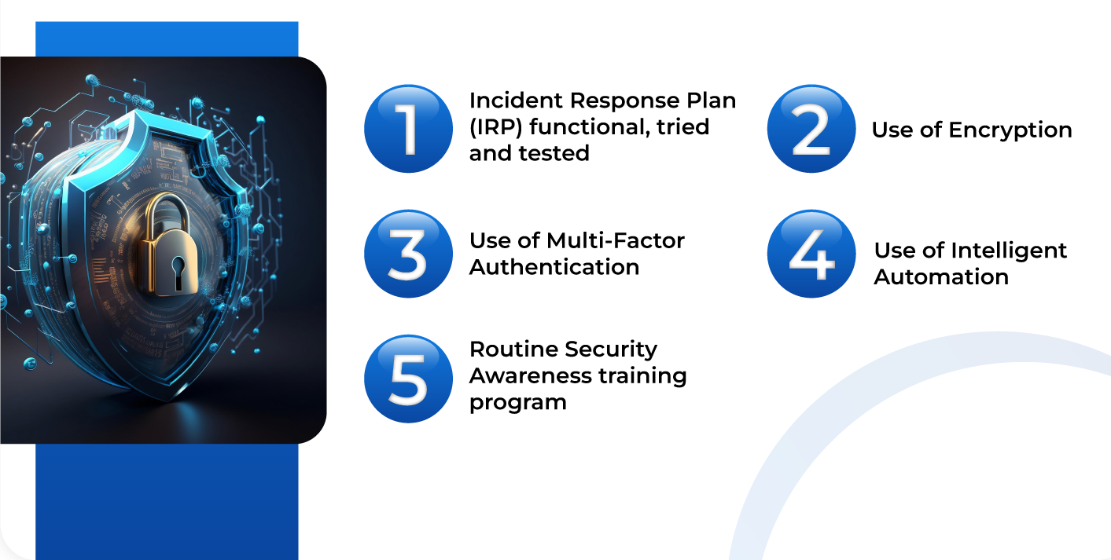
Counter measures used to prevent Data Leakage
Notes:
Human errors on the user’s side are unavoidable. That’s why enterprises must focus on creating an Incident Response Plan (IRP). Preparation, Identification ,Containment ,Eradication,
Only authorized people with a decryption key can decode and use the sensitive data.
Device-based multi-factor authentication is generally more secure and can help prevent data breaches.
Many hackers trick employees by sending phishing emails that appear authentic. Phishing emails often contain an untrustworthy link, and clicking it can compromise an organization’s data with cybercriminals.

Slide 9
Insecure API’s
APIs (Application Programming Interfaces) are integral to cloud computing services as they play a crucial role in enabling communication and interaction between different software applications and components within a cloud environment.
Insecure APIs, refer to APIs that have vulnerabilities or weaknesses in their design, implementation, or usage.
Notes:
APIs facilitate the seamless integration and interoperability of various services, allowing them to work together to deliver a cohesive and powerful computing experience.
These vulnerabilities can expose sensitive data and give huge access to cloud, compromise system integrity, and result in unauthorized access or other security breaches.

Slide 10
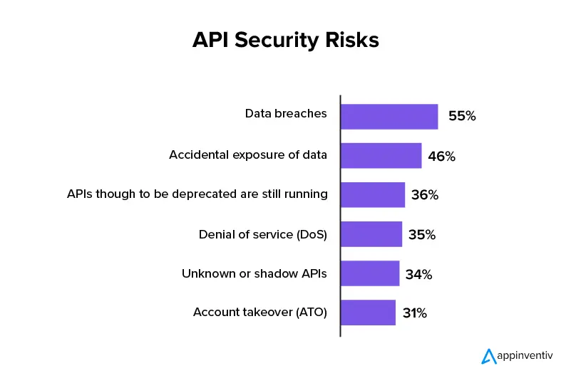
Risks of Insecure API’s
Data Breaches
Unauthorized access
Data manipulation
Service disruption
API Security best practices
Authentication and Authorization
2. Choose standard API framework
3. Web Application Firewalls
Notes:
In 2018, it was discovered that Facebook's Graph API had a vulnerability that allowed unauthorized access to user data. The vulnerability arose from an inherent flaw in the API's design, which enabled malicious actors to obtain user data without explicit consent.
Data Breach:Reputation Damage The Facebook and insecure API incident serves as a prominent example of the risks associated with insecure APIs in cloud-based platforms.

Slide 11
User Account Hijacking
User account hijacking in cloud computing refers to unauthorized access and control of a user's account within a cloud environment by an attacker.
Unauthorized Access, Credential Theft, Weak Authentication.
To mitigate these risks
Strong Authentication and Access Control
Regular Credential Rotation

Slide 12
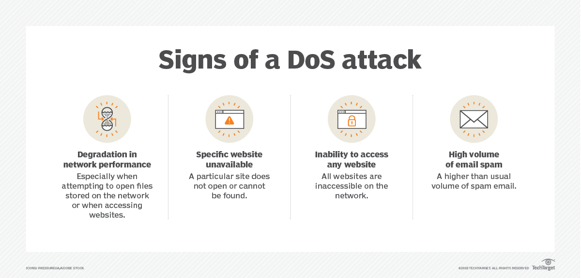
Denial of Service attacks
A Denial of Service (DoS) attack is a malicious attempt to disrupt the normal functioning of a network, service, or website by overwhelming it with a flood of illegitimate requests or traffic.

Slide 13
Mitigation Strategies of DOS Attacks
Traffic Filtering- Use firewalls, intrusion detection systems (IDS), and intrusion prevention systems (IPS) .
Rate Limiting- Implement rate limiting and throttling to restrict the number of requests from a single source.
Load Balancing- Distribute traffic across multiple servers to distribute the load and absorb excess traffic.

Slide 14
Changing service providers
Data Exposure During Migration :Data migration involves moving sensitive data from one provider's infrastructure to another.
Configuration Errors: Setting up security configurations and access controls in a new cloud environment is prone to human error.
Loss of Visibility: Organizations may lose visibility and control over their data and applications during the transition period

Slide 15
To mitigate these security risks:
Plan the migration carefully, including assessing security requirements and potential risks.
Encrypt data during migration and ensure data integrity.
Work closely with legal and compliance teams to ensure regulatory compliance.

Slide 16
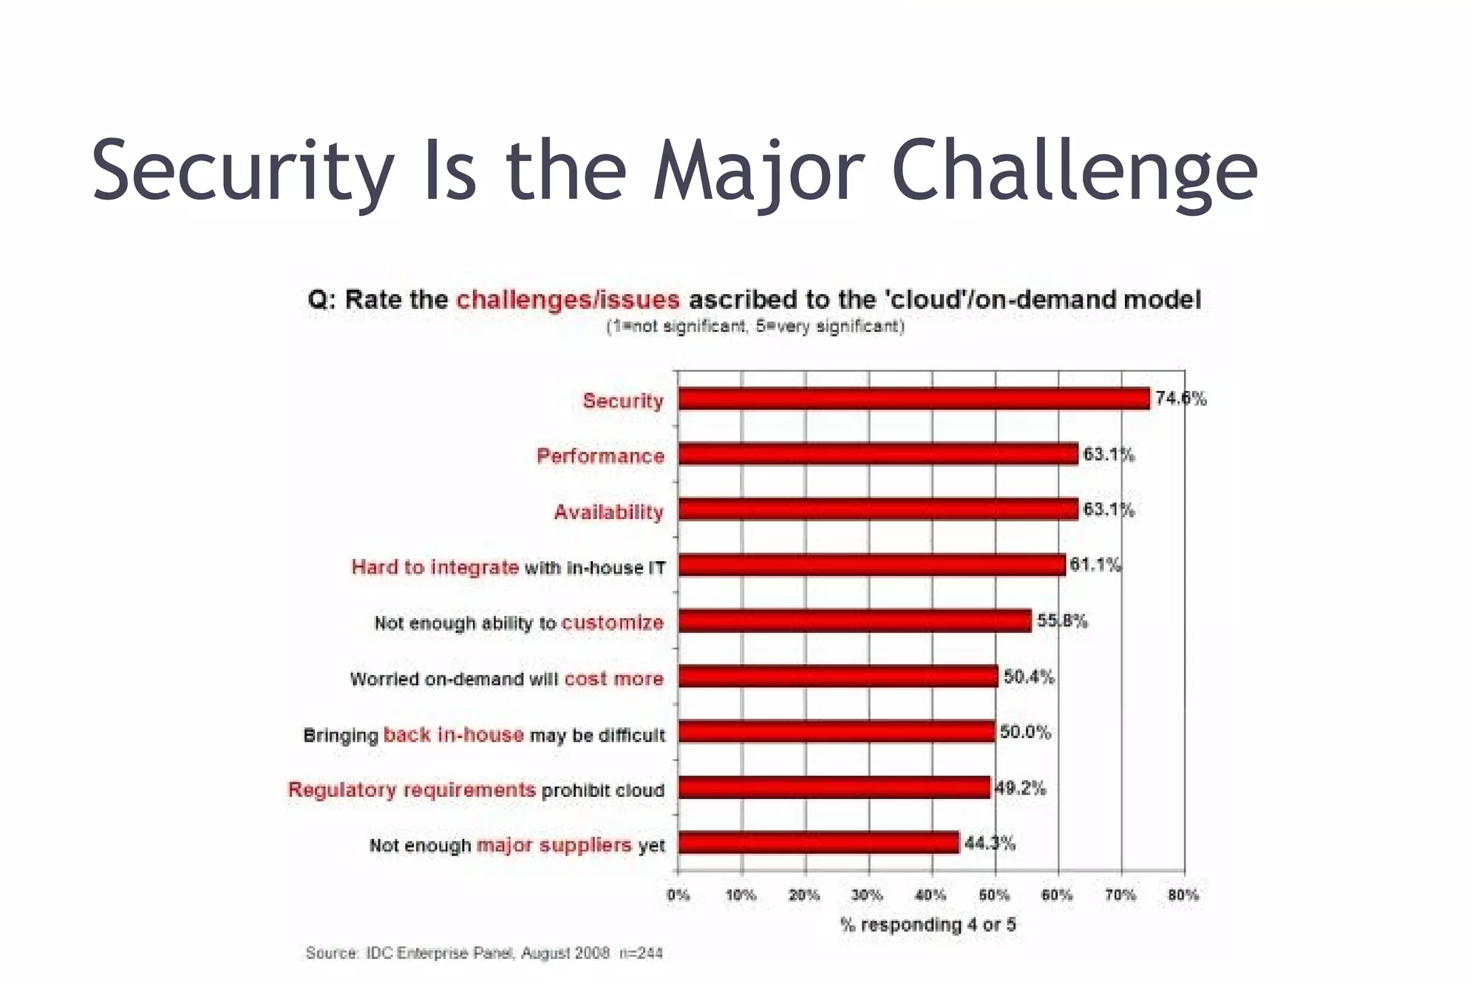
Conclusion
While cloud computing offers transformative benefits, organizations must not overlook the security risks associated with it. A comprehensive and well-implemented cloud security strategy, combined with ongoing vigilance and education, is essential for organizations to harness the advantages of the cloud while safeguarding their data and operations.
Notes:
Even though there are few limitations with cloud computing advantages outweigh the disadvantages and transitioning to the cloud has more benefits but we should overlook the security risks and follow the best security practices to enhance security .

Slide 17
References
[1] https://www.crowdstrike.com/cybersecurity-101/cloud-security/cloud-security-risks-threats-challenges/ .
[2] https://www.cloudcomputing-news.net/news/2022/aug/18/cloud-computing-security-risks/
[3] https://link.springer.com/article/10.1186/1869-0238-4-5
[4] Security Issues for Cloud Computing-https://www.igi-global.com/article/security-issues-cloud-computing/46102
[5] A survey of security issues for cloud computing Author -Ahmad Khan . A survey of security issues for cloud computing – ScienceDirect

Slide 18
Queries
&
Suggestions

Slide 19
THANK YOU…

